Slide 1
TDD, where did it all go wrong?
Kent Beck Style TDD

Slide 2
Who are you?
Software Developer for 20 years
Worked mainly for ISVs
Reuters, SunGard, Misys, Huddle
Worked for a couple of MIS departments
DTI, Beazley
Microsoft MVP for C#
Interested in OO design
Interested in Agile methodologies and practices
No smart guys
Just the guys in this room

Slide 3

Intelligent collaboration for the Enterprise
The #1 SharePoint alternative in the cloud

Slide 4
Agenda
The Problem
TDD Rebooted
Red-Green-Refactor
Clean Code When?
Refactoring to Patterns
Ports and Adapters
Behavior Driven Development
[Mocks]
[Test Data Builders]
Q&A

Slide 5
The Problem

Slide 6
Some good developers don’t want to write tests.
- Why? They are not idiots.
When we change implementation details we break tests, often dozens.
- Didn’t refactoring promise change without breaking tests?
We often write more test code than implementation code.
- There may be a reason why customers complain that adding tests is robbing us of productivity

Slide 7
Why do approaches like “Programmer Anarchy” and “Lean Software Development” want to drop test first.
- They see Test First approaches as unproductive – as obstacles to development
Why is the ‘duct tape programmer’ winning?
- They deliver functionality to customers faster, and quickly abandon tests as ‘slowing them down’
When we return to our tests – because they are broken it is often difficult to understand their intent
- Is it broken because the behavior has changed? Where is that behavior expressed?

Slide 8
We have large ATDD suites written in Fit or Cucumber
- They spend much of their life red
Customers don’t engage with our ATDD suites
- And yet we spend a lot of time maintaining them
Our ATDD suites are slow to run and increase the cost of the check-in dance
- Developers start ignoring red results
- And we have to down tools to fix them
Developers don’t want to write them
- Because they can’t see the value return on their effort
- They just want to build software

Slide 9
Where did it all go wrong?

Slide 10
TDD Rebooted
Let’s revisit the origins of our hero

Slide 11

Use The Source Luke!
A lot of folks have written TDD books. A lot of those books claim to be better introductions to TDD. For me however this remains the best text.
It is simple and elegant.
It covers the essentials of TDD, which have been misunderstood by many since.
It covers more than just the basics with topics on patterns, smells, mocks etc.
Good later work builds on it, but too much later work just misunderstands it
The goal here is to go back and talk about it
And then look at folks who built on it

Slide 12
The Zen of TDD
Avoid testing implementation details, test behaviors
A test-case per class approach fails to capture the ethos for TDD. Adding a new class is not the trigger for writing tests. The trigger is implementing a requirement.
Test outside-in, (though I would recommend using ports and adapters and making the ‘outside’ the port), writing tests to cover then use cases (scenarios, examples, GWTs etc.)
Only writing tests to cover the implementation details when you need to better understand the refactoring of the simple implementation we start with.

Slide 13


Slide 14
“When we write a test, we imagine the perfect interface for our operation. We are telling ourselves a story about how the operation will look from the outside. Our story won't always come true, but it's better to start from the best-possible application program interface (API) and work backward than to make things complicated, ugly, and “realistic” from the get-go.”
“What behavior will we need to produce the revised report? Put another way, what set of tests, when passed, will demonstrate the presence of code we are confident will compute the report correctly?
We need to be able to add amounts in two different currencies and convert the result given a set of exchange rates.
We need to be able to multiply an amount (price per share) by a number (number of shares) and receive an amount.”
Kent Beck, TDD By Example

Slide 15
What is a unit test?
For Kent Beck it is a test that ‘runs in isolation’ from other tests
Nothing more, nothing less
It is NOT to be confused with the classical unit test definition of targeting a module
We don’t touch file system, database, because these ‘shared fixture’ elements prevent us running in isolation from other tests.
Explicitly writing tests that target a method on a class, is not a TDD unit test
TDD unit tests focus on a story
Use-case, scenario…pick your poison!
In fact focusing on methods creates tests that are hard to maintain
We don’t capture the behavior we want to preserve

Slide 16
Red-Green-refactor
Writing sinful code

Slide 17
Red-Green-Refactor
1 Red Write a little test that doesn't work, and perhaps doesn't even compile at first.
2.Green Make the test work quickly, committing whatever sins necessary in the process.
3.Refactor Eliminate all of the duplication created in merely getting the test to work.
Or
Write a test.
Make it compile.
Run it to see that it fails.
Make it run.
Remove duplication.

Slide 18
The Simplest Thing
“Now I'm worried. I've given you a license to abandon all the principles of good design. Off you go to your teams—“Kent says all that design stuff doesn't matter.” Halt. The cycle is not complete. A four-legged Aeron chair falls over. The first four steps of the cycle won't work without the fifth. Good design at good times. Make it run, make it right.”
Kent Beck, TDD by Example
“The different phases have different purposes. They call for different styles of solution, different aesthetic viewpoints. The first three phases need to go by quickly, so we get to a known state with the new functionality. We can commit any number of sins to get there, because speed trumps design, just for that brief moment.”
Kent Beck, TDD by Example
Make it run. Quickly getting that bar to go to green dominates everything else.
This shift in aesthetics is hard for some experienced software engineers.
They only know how to follow the rules of good engineering.
Quick green excuses all sins.
This is not just about accepting sin, its about being sinful
Write sinful code!

Slide 19
Clean code when
How Soon is Now?

Slide 20
Clean Code Now
The Refactoring Step is when we produce clean code.
It’s when you apply patterns (see Joshua Kerievsky Refactoring to Patterns).
It’s when you remove duplication
It’s when you sanitize the code smells
You do not write new unit tests here
You are not introducing public classes
It is likely if you feel the need, you need collaborators that fulfill a role.

Slide 21
Clean Code When?
“Dependency is the key problem in software development at all scales.“ - Kent Beck, TDD By Example
We need to eliminate dependency between our tests and our code.
Tests should not depend on details, because then changing implementation breaks tests. Tests should depend on contracts or public interfaces.
This allows us to refactor implementations without changing tests
Don’t bake implementation details into tests!
Test behaviors not implementations.
Don’t test internals.
Don’t make everything public in order to test it
Preserve implementation hiding by keeping a thin public API
Refactor implementation details out, so that they do not need their own tests
Continue to refactor implementation details over time, as you want
Have expressive tests that tell you can read in the future

Slide 22
Refactoring to Patterns
Kent beck on patterns

Slide 23
Use of Design Patterns in TDD
Pattern | Test Writing | Refactoring
Command |  | X
Value Object |  | X
Null Object |  | X
Template Method |  | X
Pluggable Object |  | X
Pluggable Selector |  | X
Factory Method | X | X
Imposter | X | X
Composite | X | X
Collecting Parameter | X | X
Kent Beck, TDD By Example
Notes:
Kent Beck’s Table from Test Driven Development showing that patterns are targets of the refactoring step

Slide 24

Refactoring to Patterns
Joshua Kerievksy identified patterns as guidance for how we refactor.
We don’t try to implement patterns in the SUT – the test focuses on requirements and is likely aimed at defining a contract.
We implement patterns as improvements to the code in the refactoring step.
This prevents folks becoming ‘pattern happy’. Patterns emerge as the solutions to refactoring sinful code into clean code.
What would Jesus do? He’d sin then ask the god of patterns for forgiveness.

Slide 25
Ports and Adapters
Hexagonal Architecture

Slide 26
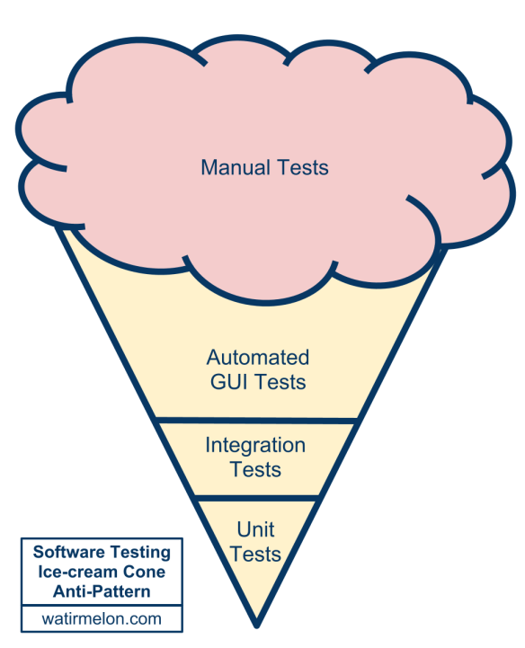

Slide 27
UI
Integration
Unit Tests
After Mike Cohn, Martin Fowler et al.

Slide 28
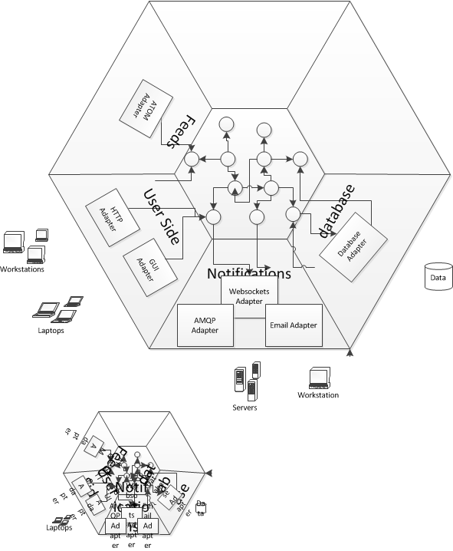

Slide 29
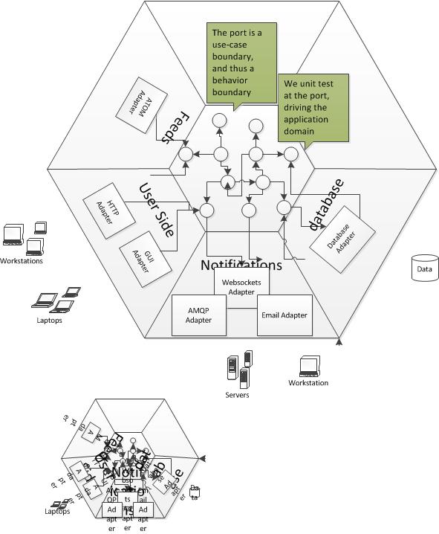

Slide 30
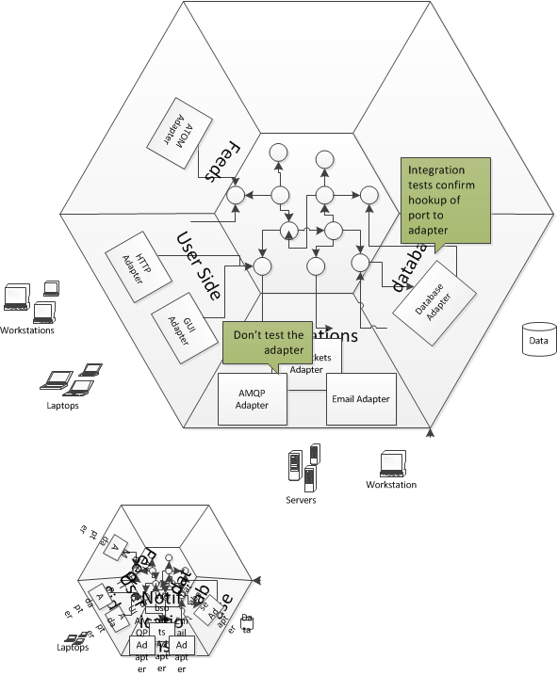
Notes:
The term "integration test" can apply to many different kinds of test. In the book, we use the term specifically to mean the test of an abstraction that we own but have implemented with some third-party package. We want to test that our code implementing the abstraction integrates with that third-party package correctly: that we have not made any incorrect assumptions about how it works or tripped over any bugs that we will have to work around. However, we cannot respond to feedback the tests give us about the internal quality of that third-party package because we cannot change it.

Slide 31
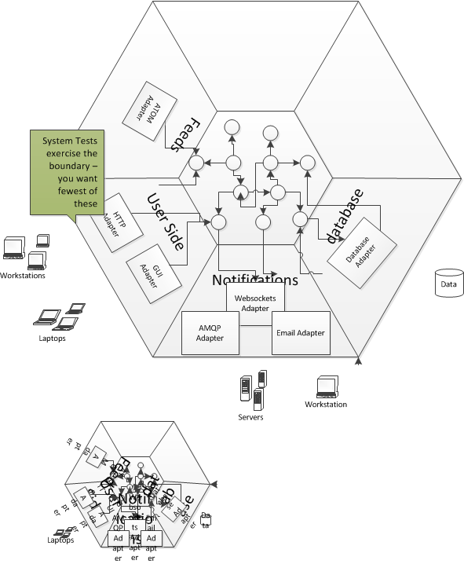

Slide 32
Gears
Driving with a shift stick

Slide 33
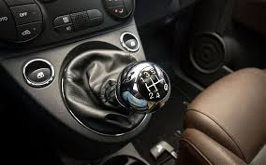

Slide 34
Acceptance Test-Driven Development

Slide 35
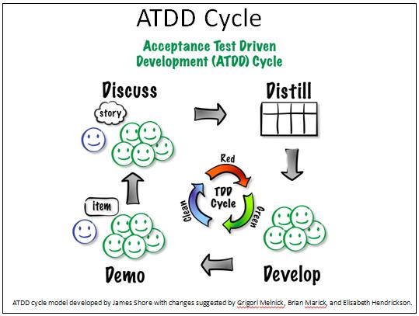
I’ve changed my mind on this over time.
I used to believe in the tools, I believed that having to pass those tests kept developers honest, they could not declare done when they felt like it. Gojko Adzic quoted me on that too.
But I think now the problem was how they wrote their unit tests – we were compensating by introducing ATDD tools to make them hit the bar. Instead, we should have been fixing the problem at source – write unit tests that focus on behaviors and thus can be used for acceptance.
If you need to surface the tests to customers, process the tests a la MSpec or SpecUnit etc .to allow customer to read
Hire QAs who are SDTs. Have them engage with the test code
“These two problems--that customers don't participate, which eliminates the purpose of acceptance testing, and that they create a significant maintenance burden, means that acceptance testing isn't worth the cost. I no longer use it or recommend it.
Instead, I involve business experts (on-site customers) closely throughout the iteration. I do have them create concrete examples, but only when faced with particularly complex topics, and never with the intention that they be run by a tool like Fit. Instead, the programmers use those examples to inform their test-driven development, which may or may not involve creating automated tests from the examples, at the programmers' discretion.”
James Shore, http://www.jamesshore.com/Blog/The-Problems-With-Acceptance-Testing.html
“One of the weaknesses of TDD as originally described is that it can devolve into a programmer’s technique used to meet a programmer’s needs. Some programmers take a broader view of TDD, facilely shifting between levels of abstraction for their tests. However, with ATDD there is no ambiguity—this is a technique for enhancing communication with people for whom programming languages are foreign. The quality of our relationships, and the communication that underlies those relationships, encourages effective software development. ATDD can be used to take a step in the direction of clearer communication”
Kent Beck, foreword to ATDD by Example

Slide 36
Behavior Driven Development

Slide 37
“BDD is a second-generation, outside-in, pull-based, multiple-stakeholder, multiple-scale, high-automation, agile methodology. It describes a cycle of interactions with well-defined outputs, resulting in the delivery of working, tested software that matters.”
Dan North, 2009 Agile specifications, BDD and Testing eXchange
BDD starts with a similar insight – that we misunderstood TDD
It creates tools like RSpec and Jbehave
It realizes that specifying scenarios is the key to driving test-driven development
It evolves into a methodology for facilitating the transmission of requirements from customer to developer through scenarios that can be automated
This presentation is about ‘fixing’ TDD, but if you believe in the story here – you might want to take that narrative further by looking into BDD.
- However, I wanted to get back to basics here – and discuss what is wrong with TDD as learned by many, as I see even people claiming to practice BDD writing poor ‘unit tests’

Slide 38
MOCKS
Removing shard fixture

Slide 39
Mock Object
Classic example is database
Long time to start
Difficult to keep ‘clean’
Tie tests to physical location on network
Write tests against something that acts like Db
Mocks can improve readability by making contents of read rows explicit (evident data)
Mocks hinder the use of singletons
Which may be a good thing
Mocks make us consider issues around coupling
We learn to inject dependencies
Mocks risk that the real system will not perform in the correct way

Slide 40
Forces
Two forces:
We want to remove ‘hard-to-test’ dependencies
Database, UI, network, file system, configuration files etc.
Depending on these makes our test fragile
We want to use Responsibility Driven Design and mock collaborators
Tell Don’t Ask
But don’t mock internals

Slide 41
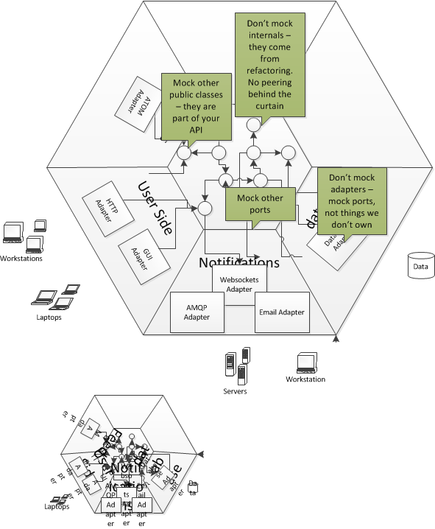

Slide 42
Object Mother and Test data Builder
Test Data and Evident Test patterns

Slide 43
Object Construction
Tests do a lot more setup of data than normal code
They don’t use repositories etc
That makes tests very noisy and leads to long setup methods.
The Test Data has a low signal to noise ratio.
We have a DRY issue. Changing our domain can ripple out across the test codebase forcing us to change a lot of tests

Slide 44
Object Mother
An early solution was object mother
A class that contains static factory methods used to create objects for use in tests
The name of the method helps identify the stereotypical object being created
The conceit was that developers would become familiar with the objects and use them in scenarios

Slide 45
Invoice invoice1 = TestInvoices.newDeerstalkerAndCapeAndSwordstickInvoice();
Invoice invoice2 =
TestInvoices.newDeerstalkerAndBootsInvoice();

Slide 46
Problems with Object Mother
Variations in testing mean we end up with many different factory methods
Object Mother soon becomes bloated
The variables affecting the test are not evident, but hidden behind the creation mechanism
If you don’t know the Object Mother test data, tests are obscure
The factory methods become shared fixture, which means that changes to construction ripple out

Slide 47
Test Data Builders
A solution is to use the Builder Pattern. For each class you want to use in a test, create a Builder for that class that:
Has an instance variable for each constructor parameter
Initialises its instance variables to commonly used or safe values
Has a `build` method that creates a new object using the values in its instance variables
We can do a neat trick with conversion operators too
Has "chainable" public methods for overriding the values in its instance variables.

Slide 48
public class InvoiceTestDataBuilder {
Recipient recipient = new RecipientTestDataBuilder().build();
InvoiceLines lines = new InvoiceLines(new InvoiceLineTestDataBuilder().build());
PoundsShillingsPence discount = PoundsShillingsPence.ZERO;
public InvoiceBuilder WithRecipient(Recipient recipient) {
this.recipient = recipient;
return this;
}
public InvoiceBuilder WithInvoiceLines(InvoiceLines lines) {
this.lines = lines;
return this;
}
public InvoiceBuilder WithDiscount(PoundsShillingsPence discount) {
this.discount = discount;
return this;
}
public Invoice Build() {
return new Invoice(recipient, lines, discount);
}
}

Slide 49
Builders and Evident Data
The use of the fluent interface – the withFoo() syntax helps highlight data affecting the test
To create the fluent interface, return the Builder itself by using return this; in the WithFoo() method
You can also use a specification, to allow you to separate the data used to construct instances from the builder
MyObjectBuilder(IAmASpecification mySpec)
Allows repeat creation of objects, variation between to be highlighted
Also allows default parameters on the specification

Slide 50
Summary
In case you slept through it

Slide 51
The reason to test is a new behavior, not a method on a class
Write dirty code to get green, then refactor
No new tests for refactored internals and privates (methods, classes)
Both Develop and Accept against tests written on a port
Add Integration tests for coverage of ports to adapters
Add system tests for end-to-end confidence
Don’t mock internals, privates, or adapters

Slide 52
Q&A
If in doubt just ask

